Slide 1
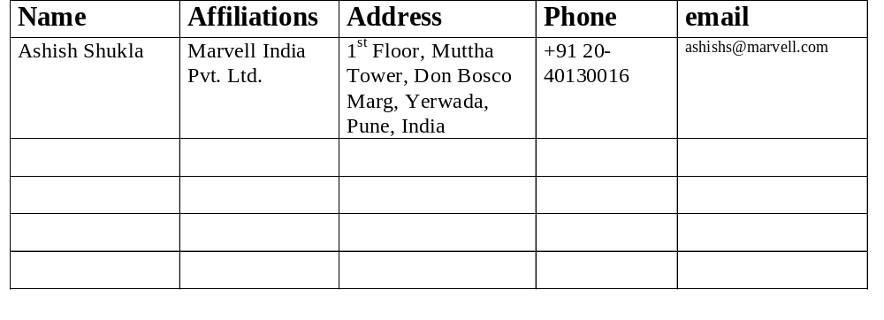
TDLS TPK Handshake
Date: 2010-05-15
Authors:

Slide 2
Abstract
This presentation identifies two problems associated with the implementation of 802.11z TPK handshake and proposed solutions:
    Setup Confirm and RX data Race condition
    Invalid Setup Confirm (TPK message 3)

Slide 3
TPK Handshake
11z specifies 3-way handshake with TPK message1 in TDLS Setup Request, TPK message2 in TDLS Setup Response, TPK message3 in TDLS Setup Confirm to establish Keys for protection of frames sent over direct link [1].
There exists a possibility of race condition, and incorrect TPK handshake state.

Slide 4
TPK Handshake
SME STA1
MLME STA1
AP
MLME STA2
SME STA2
Setup Req
Setup Response
Setup Confirm
MLME-SETKEYs
RX frames dropped (no Key)
Direct Link Frames
MLME-SETKEYs
Initiator installs Keys after receiving Setup Response (TPK MSG 2)
Initiator sends Setup Confirm (TPK MSG3), followed by data frames over direct link.
TDLS peer receives MSG3 via AP path and by the time it receives MLME-SETKEYs it might have already received encrypted frames over direct link for which it has no RX key yet.
TPK MSG1
TPK MSG2
TPK MSG3

Slide 5
TPK Handshake
In the absence of RX Key, TDLS peer might drop received frames (e.g., TCP message, frame such as TDLS Channel Switch Request). The amount of loss depends on the time it takes to receive MLME-SETKEYS.Request primitive after receiving TPK MSG 3.
Solution 1:
  Delay Processing Received frame till RX Key gets installed after receiving Setup Confirm
    Since there is no flow control, what if sender keeps sending and RX buffers get full.
    Therefore, this does not sound foolproof.

Slide 6
TPK Handshake
Solution 2:
  Install Key early
    TDLS Peer
      Install RX key after processing TPK MSG1 and before sending TPK MSG2.
      If no valid Setup Confirm within a timeout, or TPK MSG2 transmission fails, delete TPKSA.
    TDLS initiator,
      Install Key after validating Message 2 and before sending Message 3

Slide 7
TPK Handshake
Solution 3:
  Add a fourth message TDLS Setup Confirm Ack to make it similar to 4-way handshake.
  TDLS Initiator would install Key after validating Message 2 and before sending Message 3.
  TDLS responder would install Keys after validating message 3 and then respond with TDLS Setup Confirm Ack.
  Initiator after receiving TDLS Setup Confirm Ack would resume data traffic over direct link.

Slide 8
Invalid TPK Message 3
As per the [1], Setup Confirm (TPK Message 3) is discarded if not valid.
It’s not clear how TDLS initiator would discover this fact. There could be frame loss before it discovers that Setup Confirm has failed to establish TPKSA.
Solution 1:
  After receiving N consecutive individually addressed frames from the initiator with no valid RX key, TDLS responder may send TDLS Link Tear down message to Initiator to inform this fact.
  But, since Initiator has a valid key it would expect Link Tear Down encrypted, which would not be the case as TDLS responder does not have a valid Key.
  A TDLS link tear down frame therefore shall be sent using AP path (initiator ←→ AP ←→ Responder path is anyway secure) to initiator –need to change the spec to allow this (currently AP path is only using during off-channel operation)
  Contents of TDLS Link Teardown message:
    SNonce as received in message 1, ANonce as set in FTIE by this STA as part of TPK message 2, MIC zero.
    Possibly new Reason code “Frame received from a STA from which this STA has no Direct Link Setup”
  Initiator after receiving teardown (and validating ANonce, SNonce, etc) shall stop transmission over direct link and if required, reinitiate TDLS Setup.

Slide 9
Invalid TPK Message 3
Solution 2:
  Same as Solution 3 for TPK key installation race condition
  Inclusion of 4th Message TDLS Setup Confirm Ack would solve this problem as well.
  Initiator if failed to receive TDLS Setup Confirm Ack within a predefined timeout would destroy TPKSA.

Slide 10
References
IEEE P802.11z /D8.0

